Slide 1
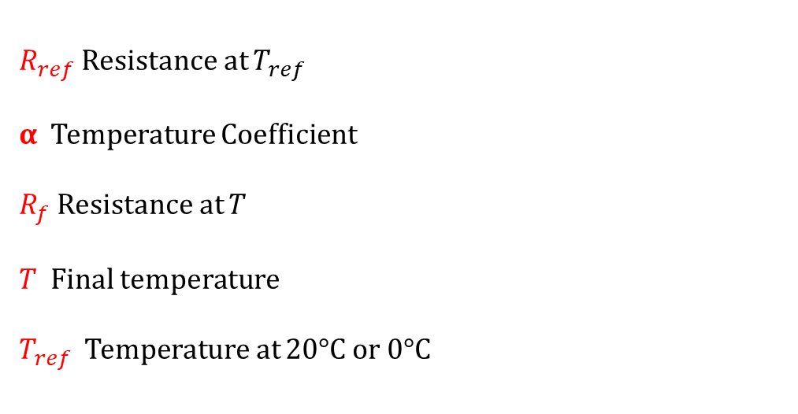
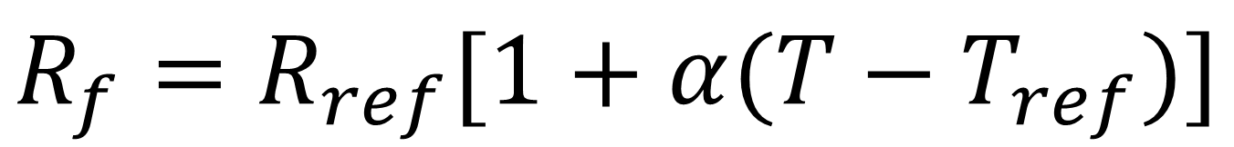
Buda Tech
Temperature coefficient α
$$R_{f}=R_{ref}[1+α(T−T_{ref})]$$
$R_{ref}$ Resistance at $T_{ref}$
α Temperature Coefficient
$R_{f}$ Resistance at $T$
$T$ Final temperature
$T_{ref}$ Temperature at 20°C or 0°C

Slide 2
Buda Tech
Temperature coefficient of Resistance α
$$R_{f}=R_{ref}[1+α(T−T_{ref})]$$
(α) Constant is known as the temperature coefficient of resistance and symbolizes the resistance change factor per degree of temperature change.
as all materials have a certain specific resistance (at 20° C), they also change resistance according to temperature by certain amounts.
For pure metals, this coefficient is a positive number, meaning that resistance increases with increasing temperature.
For the elements carbon, silicon, and germanium, this coefficient is a negative number, meaning that resistance decreases with increasing temperature.

Slide 3
Buda Tech
Temperature coefficient of Resistance α
$$R_{f}=R_{ref}[1+α(T−T_{ref})]$$
For some metal alloys, the temperature coefficient of resistance is very close to zero, meaning that the resistance hardly changes at all with temperature variations (a good property if you want to build a precision resistor out of metal wire!)

Slide 4
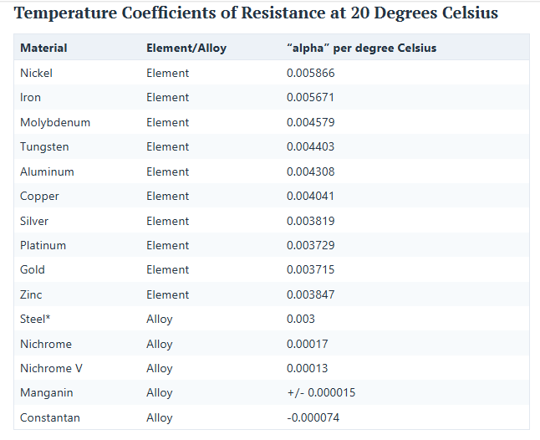
Buda Tech
Temperature coefficient of Resistance α

Slide 5
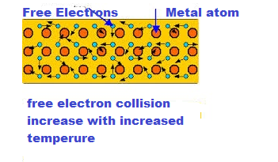
Buda Tech
Temperature coefficient of Resistance α
Why resistance of metallic substances increases with an increase in temperature?
The metals have free electrons moving randomly in the crystal structure. With an increase in temperature, the random motion of free electrons and inter-atomic vibration increase, and as a result, the collision rate between electrons inside the metal increases.

Slide 6
Buda Tech
Temperature coefficient of Resistance α
Why resistance of metallic substances increases with an increase in temperature?
The increased collision rate impedes the flow of the electron through the metal, and thus, the resistance of the metal increases. Therefore, the temperature coefficient of the metals is positive.
Contrary to metallic substance, the resistance of the semiconductor and insulator substances decrease with an increase in temperature. The semiconductor and insulator material has a negative temperature coefficient..

Slide 7
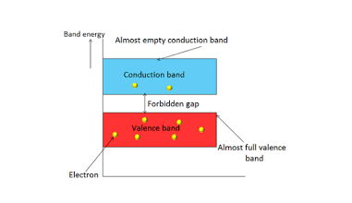
Buda Tech
Temperature coefficient of Resistance α
Why resistance of non-metallic substances decrease with an increase in temperature?
With an increase in temperature, the heat energy in the crystal increases, and as a result, the covalent bonds start breaking and releasing more electrons in the crystal. Now, more electrons leave the valence band, pass through the forbidden gap, and reach the conduction band.

Slide 8
Buda Tech
Temperature coefficient of Resistance α
Why resistance of non-metallic substances decrease with an increase in temperature?
The number of free electrons reaching from the valence band to the conduction band increases with an increase in the temperature. Hence, the resistance of the non-metallic substance decreases with an increase in temperature.

Slide 9
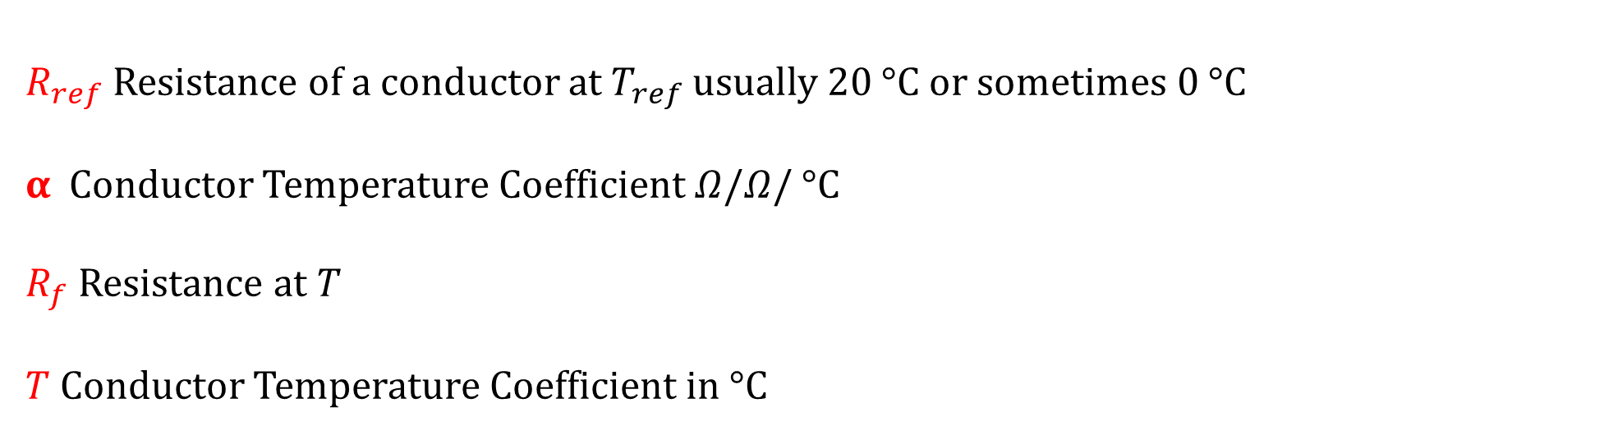
Buda Tech
Temperature coefficient of Resistance α
$$R_{f}=R_{ref}[1+α(T−T_{ref})]$$
$R_{ref}$ Resistance of a conductor at $T_{ref}$ usually 20 °C or sometimes 0 °C
α Conductor Temperature Coefficient $Ω/Ω$/ °C
$R_{f}$ Resistance at $T$
$T$ Conductor Temperature Coefficient in °C

Slide 10
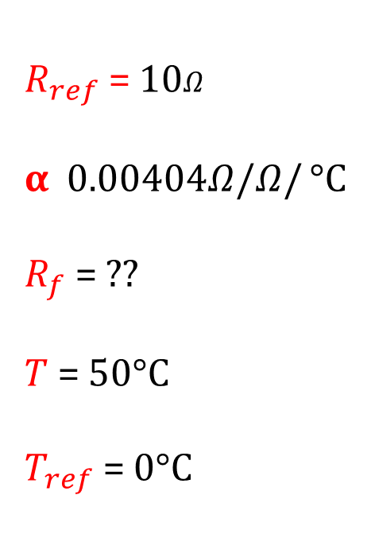
Buda Tech
Temperature coefficient of Resistance α
Example
A sample of copper has a resistance of 10Ω at a temperature of 0°C. What will be
its resistance at 50°C?
$R_{ref}$ = 10$Ω$
α 0.00404$Ω/Ω$/ °C
$R_{f}$ = ??
$T$ = 50°C
$T_{ref}$ = 0°C
$$R_{f}=R_{ref}[1+α\left(T−T_{ref})\right]$$

Slide 11

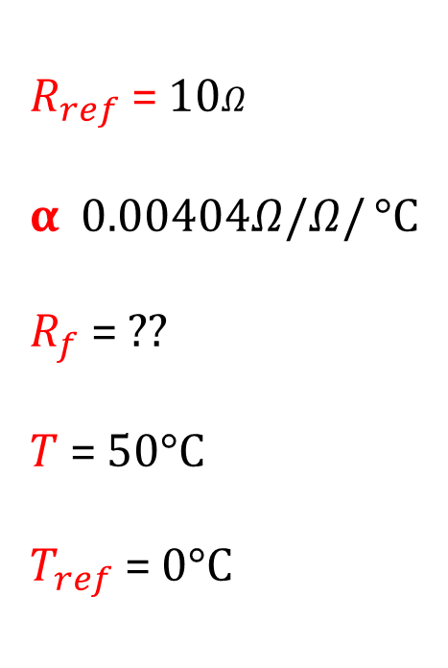
Buda Tech
Temperature coefficient of Resistance α
Example
A sample of copper has a resistance of 10Ω at a temperature of 0°C. What will be
its resistance at 50°C?
$R_{ref}$ = 10$Ω$
α 0.00404$Ω/Ω$/ °C
$R_{f}$ = ??
$T$ = 50°C
$T_{ref}$ = 0°C
$$R_{f}=R_{ref}[1+α\left(T−T_{ref})\right]$$
${ R}_{f}=10[1+0.00404\left(50−0)\right]$
${ R}_{f}=10[1+0.00404\left(50)\right]$
$${ R}_{f}=10\left[1+0.202\right]$$
$${ R}_{f}=10\left[1.202\right]$$
${ R}_{f}=12$ Ω

Slide 12

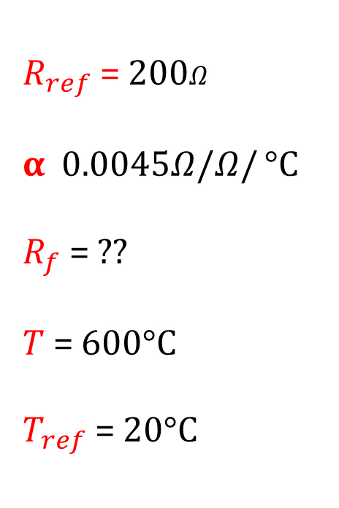
Buda Tech
Temperature coefficient of Resistance α
Example
A length of tungsten filament wire has a resistance of 200Ω at 20°C. What will be
its resistance at 600°C ( α = 0.0045 Ω / Ω /°C)?
$R_{ref}$ = 200$Ω$
α 0.0045$Ω/Ω$/ °C
$R_{f}$ = ??
$T$ = 600°C
$T_{ref}$ = 20°C
$$R_{f}=R_{ref}[1+α\left(T−T_{ref})\right]$$

Slide 13

Buda Tech
Temperature coefficient of Resistance α
Example
A length of tungsten filament wire has a resistance of 200Ω at 20°C. What will be
its resistance at 600°C ( α = 0.0045 Ω / Ω /°C)?
$R_{ref}$ = 200$Ω$
α 0.0045$Ω/Ω$/ °C
$R_{f}$ = ??
$T$ = 600°C
$T_{ref}$ = 20°C
$$R_{f}=R_{ref}[1+α\left(T−T_{ref})\right]$$
${ R}_{f}=200[1+0.0045\left(600−20)\right]$
${ R}_{f}=200[1+0.0045\left(580)\right]$
$${ R}_{f}=200\left[1+2.61\right]$$
$${ R}_{f}=200\left[3.61\right]$$
${ R}_{f}=722$ Ω

Slide 14
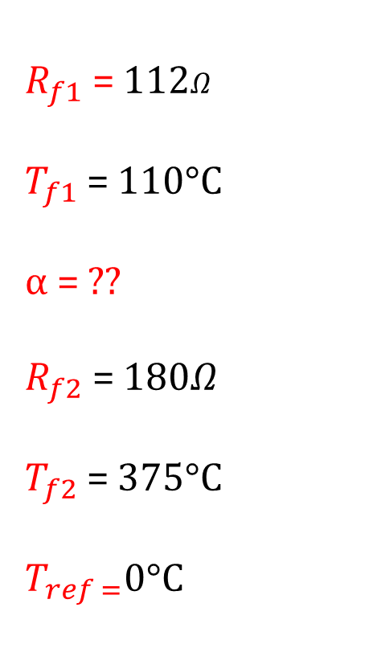
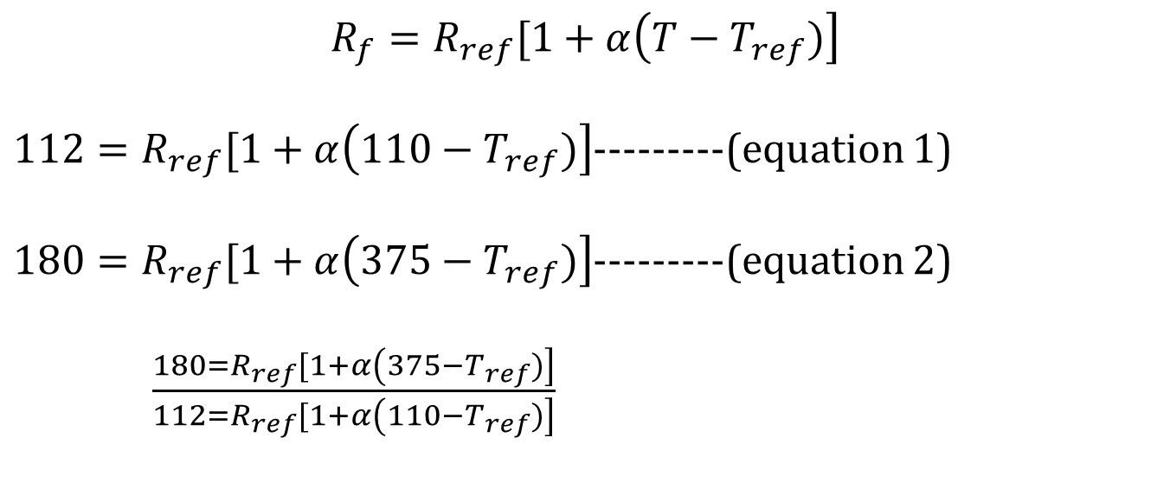
Buda Tech
Temperature coefficient of Resistance α
Example
The resistance of a bulb filament is 112Ω at a temperature of 110°C. and its resistance is 180Ω at 375 °C. Calculate its temperate coefficient.
$R_{f1}$ = 112$Ω$
$T_{f1}$ = 110°C
α = ??
$R_{f2}$ = 180$Ω$
$T_{f2}$ = 375°C
$T_{ref =}$0°C
$$R_{f}=R_{ref}[1+α\left(T−T_{ref})\right]$$
$112=R_{ref}[1+α\left(110−T_{ref})\right]$---------(equation 1)
$180=R_{ref}[1+α\left(375−T_{ref})\right]$---------(equation 2)
$\frac{180=R_{ref}[1+α\left(375−T_{ref})\right]}{112=R_{ref}[1+α\left(110−T_{ref})\right]}$

Slide 15
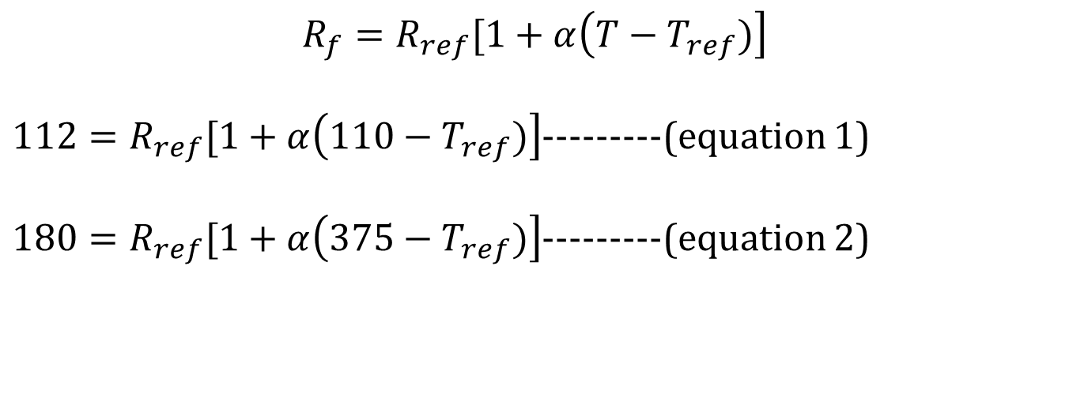
Buda Tech
Temperature coefficient of Resistance α
Example
The resistance of a bulb filament is 112Ω at a temperature of 110°C. and its resistance is 180Ω at 375 °C. Calculate its temperate coefficient.
$R_{f1}$ = 112$Ω$
$T_{f1}$ = 110°C
α = ??
$R_{f2}$ = 180$Ω$
$T_{f2}$ = 375°C
$T_{ref =}$0°C
$$R_{f}=R_{ref}[1+α\left(T−T_{ref})\right]$$
$112=R_{ref}[1+α\left(110−T_{ref})\right]$---------(equation 1)
$180=R_{ref}[1+α\left(375−T_{ref})\right]$---------(equation 2)

Slide 16
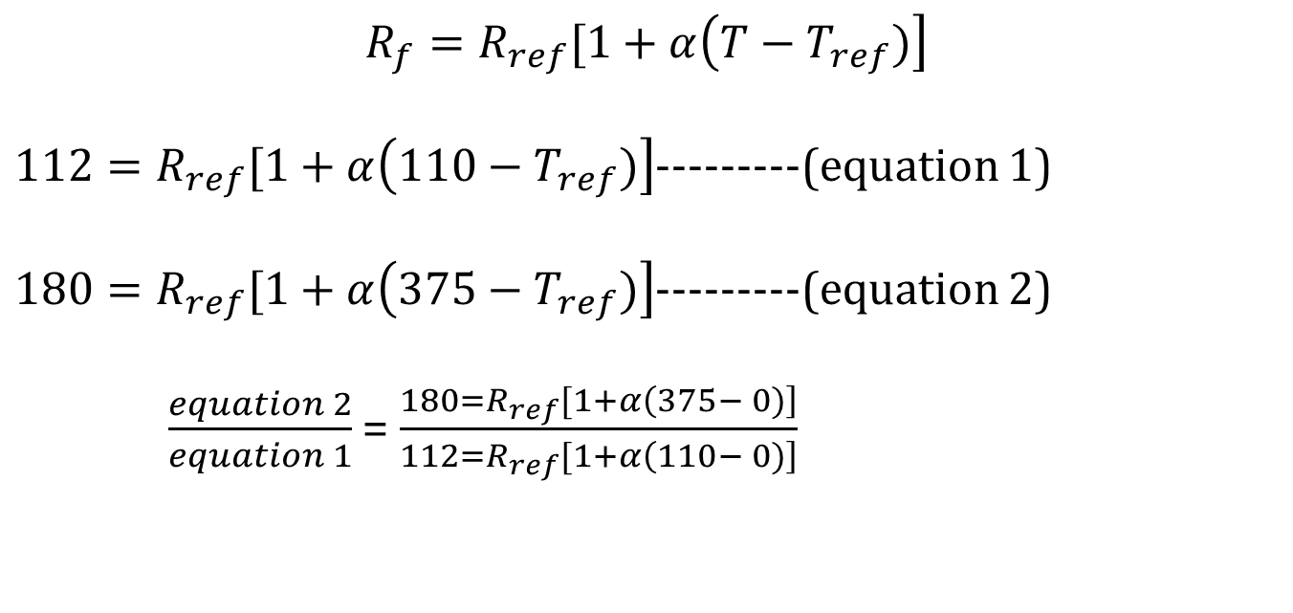
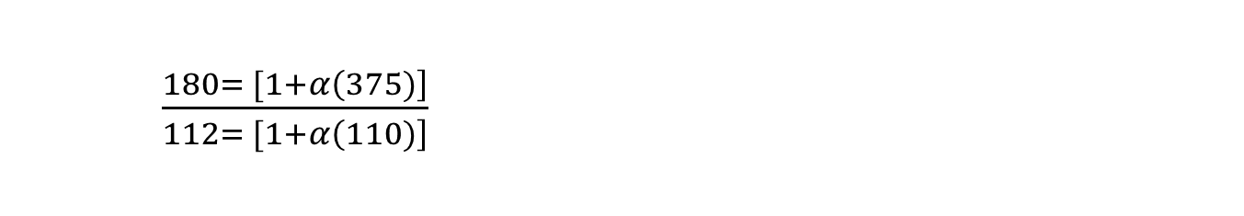
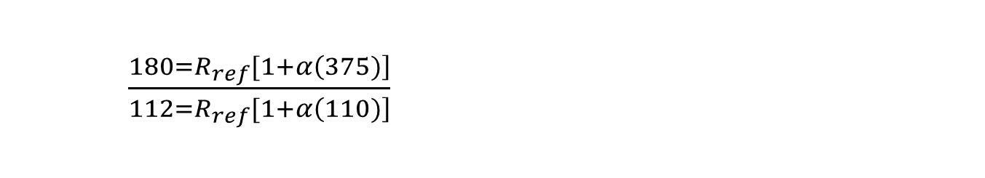
Buda Tech
Temperature coefficient of Resistance α
$$R_{f}=R_{ref}[1+α\left(T−T_{ref})\right]$$
$112=R_{ref}[1+α\left(110−T_{ref})\right]$---------(equation 1)
$180=R_{ref}[1+α\left(375−T_{ref})\right]$---------(equation 2)
$\frac{equation 2}{equation 1}$ = $\frac{180=R_{ref}[1+α\left(375− 0)\right]}{112=R_{ref}[1+α\left(110− 0)\right]}$
$\frac{180=R_{ref}[1+α\left(375)\right]}{112=R_{ref}[1+α\left(110)\right]}$
$\frac{180= [1+α\left(375)\right]}{112= [1+α\left(110)\right]}$

Slide 17
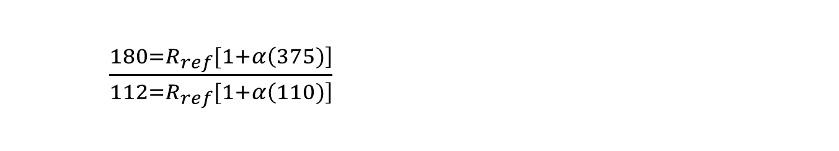
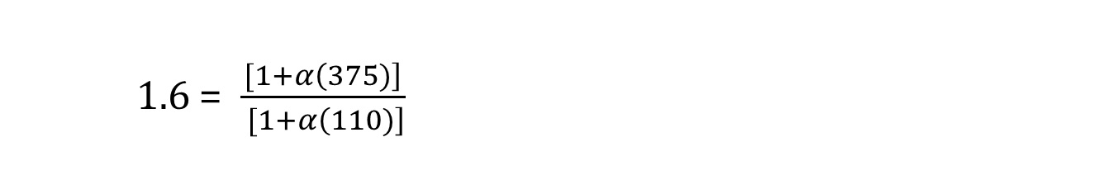
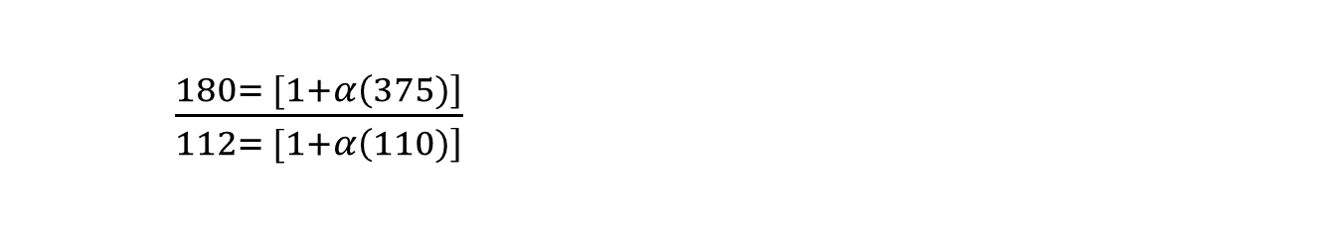
Buda Tech
Temperature coefficient of Resistance α
$\frac{180=R_{ref}[1+α\left(375)\right]}{112=R_{ref}[1+α\left(110)\right]}$
$\frac{180= [1+α\left(375)\right]}{112= [1+α\left(110)\right]}$
1.6 = $\frac{[1+α\left(375)\right]}{ [1+α\left(110)\right]}$

Slide 18

Buda Tech
Temperature coefficient of Resistance α
$\frac{180=R_{ref}[1+α\left(375)\right]}{112=R_{ref}[1+α\left(110)\right]}$
$\frac{180= [1+α\left(375)\right]}{112= [1+α\left(110)\right]}$
1.6 = $\frac{[1+α\left(375)\right]}{ [1+α\left(110)\right]}$
1.6 $[1+α\left(110)\right]$ = $[1+α\left(375)\right]$
1.6 + 176 $α$ = 1 + $375$ $α$
1.6 - 1 = $375$ $α$ - 176 $α$
0.6 = 199$α$

Slide 19

Buda Tech
Temperature coefficient of Resistance α
1.6 + 176 $α$ = 1 + $375$ $α$
1.6 - 1 = $375$ $α$ - 176 $α$
0.6 = 199$α$
$α$ = $\frac{0.6}{199}$
$α$ = 0.003015Ω/Ω/°C

Slide 20
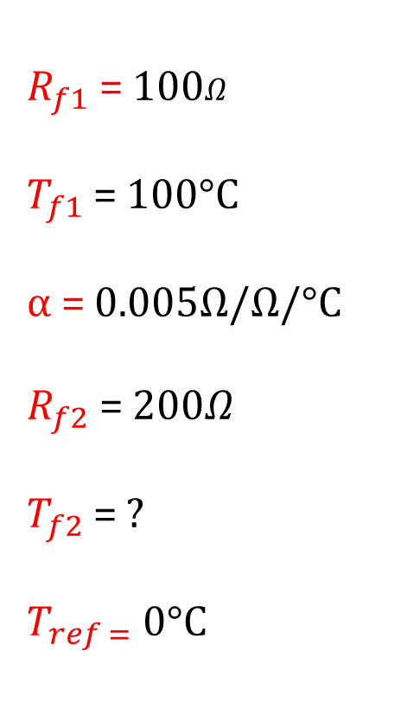

Buda Tech
Temperature coefficient of Resistance α
Example
The resistance of a bulb filament is 100Ω at a temperature of 100°C. If its TCR is 0.005 per °C, its resistance will become 200Ω at a temperature of?
$R_{f1}$ = 100$Ω$
$T_{f1}$ = 100°C
α = 0.005Ω/Ω/°C
$R_{f2}$ = 200$Ω$
$T_{f2}$ = ?
$T_{ref =}$0°C
$$R_{f}=R_{ref}[1+α\left(T−T_{ref})\right]$$

Slide 21
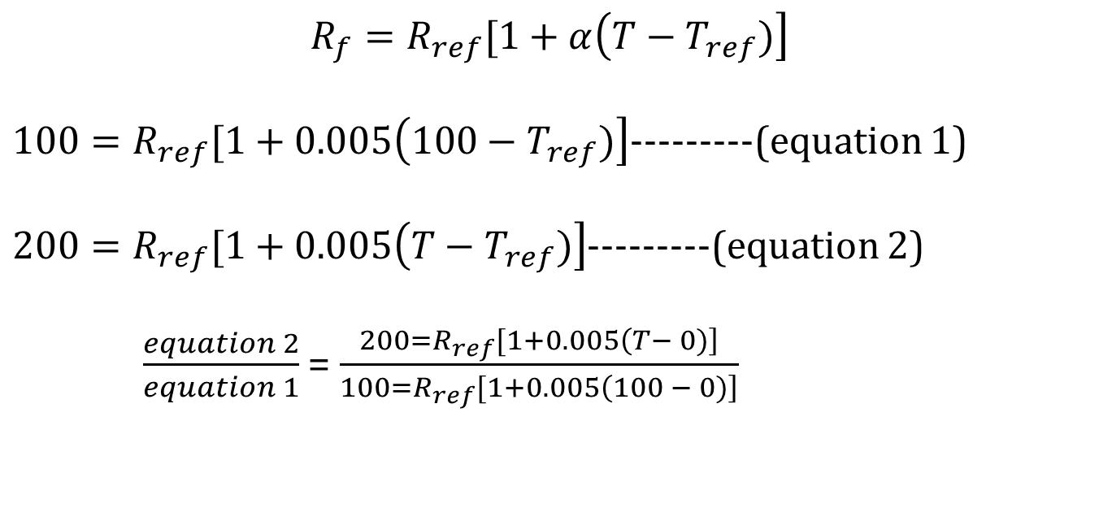
Buda Tech
Temperature coefficient of Resistance α
$$R_{f}=R_{ref}[1+α\left(T−T_{ref})\right]$$
$100=R_{ref}[1+0.005\left(100−T_{ref})\right]$---------(equation 1)
$200=R_{ref}[1+0.005\left(T−T_{ref})\right]$---------(equation 2)
$\frac{equation 2}{equation 1}$ = $\frac{200=R_{ref}[1+0.005\left(T− 0)\right]}{100=R_{ref}[1+0.005\left(100 − 0)\right]}$

Slide 22
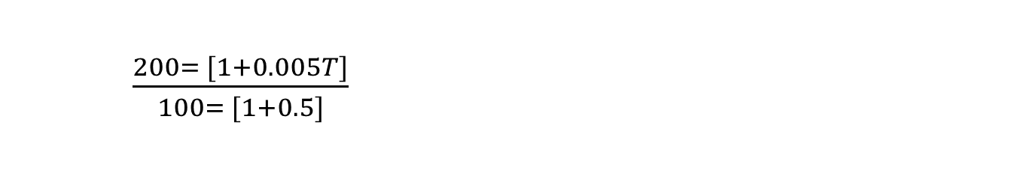
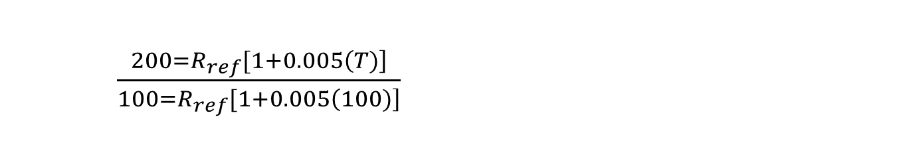
Buda Tech
Temperature coefficient of Resistance α
$$R_{f}=R_{ref}[1+α\left(T−T_{ref})\right]$$
$100=R_{ref}[1+0.005\left(100−T_{ref})\right]$---------(equation 1)
$200=R_{ref}[1+0.005\left(T−T_{ref})\right]$---------(equation 2)
$\frac{equation 2}{equation 1}$ = $\frac{200=R_{ref}[1+0.005\left(T− 0)\right]}{100=R_{ref}[1+0.005\left(100 − 0)\right]}$
$\frac{200=R_{ref}[1+0.005\left(T)\right]}{100=R_{ref}[1+0.005\left(100)\right]}$
$\frac{200= [1+0.005T]}{100= [1+0.5]}$

Slide 23
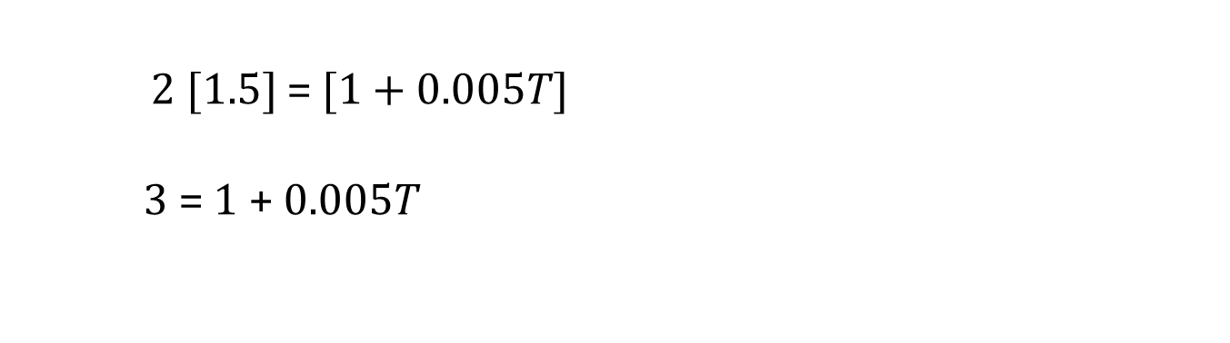
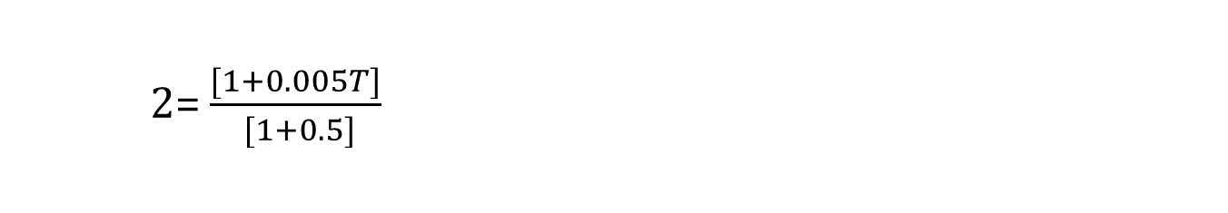
Buda Tech
Temperature coefficient of Resistance α
2= $\frac{[1+0.005T]}{ [1+0.5]}$
2 $[1.5]$ = $[1+0.005T]$
3 = 1 + $0.005T$

Slide 24

Buda Tech
Temperature coefficient of Resistance α
2= $\frac{[1+0.005T]}{ [1+0.5]}$
2 $[1.5]$ = $[1+0.005T]$
3 = 1 + $0.005T$
3 - 1 = $0.005T$
2 = $0.005T$
$T$ = $\frac{2}{0.005}$
$T$ = 400°C

